Slide 1


Tree.st.
Get to Know Everyone.
Discover the amazing people within your organization by their qualities.
Dec. 7, 2012 for Bain Capital Fast-Pitch Series

Slide 2

/ Agenda
1. Project Overview
2. Why Social Discovery?
3. Problem Summary
4. How Tree.st Works
5. Competitive Edge – Professional Networks
6. Competitive Edge – Consumer Communities
7. Validation Case Study – MIT
8. Competition & Monetization
Appendix A-E

Slide 3
/ Project Overview
In the span of one year, Tree.st’s main product was developed from the ground up via 60+ face-to-face interviews
MAIN PRODUCT | www.tree.st
DEMO VIDEOS | www.tree.st/d/how
DEMO COMMUNITY | www.tree.st/mit
INTELLECTUAL | 1 Provisional
VALIDATION | Tested with 700+ users
 | Product-market-fit shown
NEXT STEPS | Develop commercialization page
 | Develop marketing material
 | Develop sales funnel
 | Customer-acquisition validation
Notes:
Add: Team point

Slide 4
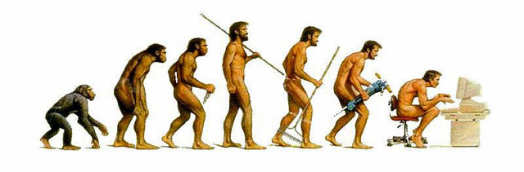
/ Why Social Discovery?
Humans are social beings. To socialize, we group ourselves based on the traits we find in the people around us
Vision allowed the caveman to see physical traits in others to build teams to achieve goals and innovate
Today we are blind, as there are few tools for individuals in organizations to find one another based on intellectual traits

Slide 5



/ Problem Summary
As globalization removes national barriers, companies will compete more and more on a global level. As a consequence, the innovation these companies generate will be the greatest differentiator between winners and losers.
The greatest barrier of innovation is silo-ed thinking. Departmental silos, program silos, functional silos, and cultural silos – impede innovation at organizations from taking place. If silo-ed thinking is innovation’s greatest barrier, inter-disciplinary, inter-cultural and inter-departmental communication is its greatest driver¹.
This is an urgent and very real problem. Much research from Prof. Piskorski (HBS)², Anthony J. Bradley (VP at Gartner Research)³, among other premier research groups has been done in this space. When one analyzes why Kodak’s market share has significantly dropped, or why Apple has exploded with success, the existence or the lack of silo-ed communication is at the center of the conversation.
[1] “Medici Effect.” [2] Piskorski, Mikolaj Jan. "Social Strategies That Work." Harvard Business Review 89, no. 11 (November 2011): 116–122. [3] Bradley, Anthony J. “The Social Organization.” Harvard Review Press

Slide 6



/ How
Tree.st creates customizable social discovery and networking tools for organizations and communities. Via a four-step process Tree.st allows people to easily find one another to innovate and/or create value
GATHER
SEARCH
GROUPS
COMMUNICATE
We ask members a series of specific questions to gather micro-level qualities – that is, qualities specific to the organization or community
Enable members to formulate rich search queries based on the same unique qualities that were gathered from a population
Members create “smart” groups – groups that automatically subscribe members that match a desired set of qualities
Members with very specific qualities and interests self-organize themselves and begin communicating
Appendix A
Appendix B
Appendix C
Appendix D
Tree.st communities have a strong sense of purpose. Via optional gamification modules and competitions we create a culture of innovation
Social Discovery
Gamification & Goals
Innovation
Tree.st creates a medium where members can find one another
Incentivizes members to create diverse teams to solve challenges
Creates results where business value can be derived

Slide 7


/ Competitive Edge (Professional Networks)
KEY
LinkedIn and Yammer only gather broad qualities about professionals, such as their education, fields, roles, etc.
Tree.st on the other hand can gather any number of micro-level qualities specific for each profession, enabling professionals to find one another via complex searches.
If Tree.st were to create profession-specific communities:
All 3rd grade teachers could find one another and begin creating better curricula. All anesthesiologists that use XYZ drug could find one another and discuss patient side-effects. All MBA students nationwide could find each other based on interests, goals, ambitions.
If organizations and businesses were to have their own private Tree.st communities, employees would be able to easily find one another and jump across departmental or functional silos.
Broad qualities
Micro qualities
Broad Qualities
Role
Career
Education
Location
Micro Qualities
Professions
Lawyers
Doctors
Pilots
Pepsi
Personality
Patients
Airplanes
Brand Focus
Judges
Specialties
License Type
Geography
Cases
Approach
Experience
Department
Wins
Work Style
Airports
Years at …
Creativity
Tree.st
Analytical

Slide 8



/ Competitive Edge (Consumer Networks)
KEY
Facebook has limited search functionality and depth. As a consequence, Ark has been well received by audiences and investors.
Yet Ark will always be restricted to the broad qualities it can gather from the Facebook and LinkedIn API. Unlike Facebook or Ark, Tree.st can host countless public communities that provide its members a feature-rich search engine that uses both broad and micro-level qualities. Such functionality could enable:
All the Latin parents that like sailing to find one another. All the youngsters that play Xbox’s Halo around a block to know one another. All the single gluten-free folks that play an instrument to hold concerts.
Because of Tree.st’s gamification functionality our public facing communities will not use an advertisement model, but will rather use a point-based monetization strategy (See Appendix B) where members pay by usage.
Broad qualities
Micro qualities
Location
Education
Workplace
Limitless Search Options
Personality
Patients
Veteran
Explorer
Sports
Specialties
Married
Deaf
Books Read
Parent
Height
Traveled to
Single
Work Style
Hobbies
Languages
Artistic
Tree.st
Skills
Gamer
Religion

Slide 9
/ Validation Case Study (MIT)
We validated Tree.st at MIT with 700+ students by creating three nested communities
MIT
Currently 10% of MIT graduates use Tree.st to find each one another based on a number of unique qualities never before gathered – including “shoe size”
Potential inter-departmental collaborations led to a meeting with Dean of Graduate Students and the Dean of Student Life to potentially institutionalize the MIT Tree.st community in the coming years
10% of MIT graduates
Inter-departmental comm.
Improved student life
MIT SLOAN
In the first two weeks on Fall 2012 40% of all current MIT Sloan students joined the MIT Sloan Tree.st community. Each was characterize with 45 unique qualities. The MIT Sloan Tree.st community became the one and only place where MIT Sloan students could easily discover others. For example: all the female, gluten-free, ex-consultants living in Central Square connected with one another. Tool created enough attention to create a news article in school newsletter
40% of school in 2 weeks
45 unique qualities
20+ “Smart Groups”
ENTREPRENEURSHIP & INNOVATION TRACK
Prof. Edward Roberts saw value in the Tree.st to create diverse entrepreneurial teams for the Entrepreneurship Track. MIT Sloan Entrepreneurs grouped themselves before school started by industry, geographical region, and goals of interest. This allowed the innovators to begin communicating with one another before classes began
Soon we were contacted by Peter Thiel’s (founder PayPal) Foundation to setup a similar community for their mentor mentee network
58 unique qualities
Grouped by industry
Contacted by Peter Thiel’s Foundation
Notes:
We released Tree.st to the MIT community a few months ago.
And over 700 students joined tree and engaged in the wide array of nested communities.
From the broadest perspective
This included 10% of MIT graduate students.
At the inter-departmental community level (Sloan Business School and the School of Engineering)
Within Sloan
40% of the students joined within the first 2 weeks of release
These students were characterized by 45 unique qualities
funneled into over 20 different “Smart Groups”
Entrepreneurship & Innovation Track is a community nested within the Sloan community
And is characterized by 58 unique attributes
This community allowed entrepreneurs at sloan to engage and communicate before the semester even began
At MIT we already spoke to many stakeholders at the administration level including
Dean of Student life
President Rief of MIT
Who were all very supportive of tree and the implications it can have on the MIT community
The Peter Thiel foundation to setup a similar community for their mentor/mentee network

Slide 10
/ Competition & Monetization
Competition For professional discoverability only Negligible for other industries |  | Monetization, LV, and Scale Appendix E
DIRECT |  | MONETIZATION
N/A |  | Initially pure-play B2B SaaS model, later will add on-premise solution for enterprises, followed by public facing Tree.st communities for niche-populations using an advertisement model
POTENTIALLY DIRECT |  | LIFETIME VALUE
Ark.com Yammer.com, Basecamp.com Convo.com Kohort.com |  | We expect customer lifetime value to be high since Tree.st collects micro-level qualities not available anywhere else. Though customer has data ownership, the Tree.st data structure and intellectual property makes it impractical for customer use
INDIRECT |  | SCALE
LinkedIn.com Contains a professional social discoverability feature, monetization requires search engine to have limited usage to most users |  | Given the decentralized nature of the engineering behind Tree.st – scalability is not a problem. Most initial capital will be used for sales and marketing after customer acquisition validation is complete
Notes:
Currently, we have no direct competitors offering social discovery like tree
However we do anticipate competition from social engagement platforms, people search and internal collaboration tools .
indirectly,
We anticipate competition from linkedin
Although their main competing feature is built into their monetization strategy and limited to most users
To Monetize our business
We will Initially set up as a pure-play B2B SAAS model
Where communities can utilize user intuitive platform without any engineering background to customize tree for their brand and community
Then we will add on-premise solutions for enterprises
That will seamlessly integrate with their work flow and operate behind their firewall
Eventually we want to open up to public facing Tree communities for niche populations
For example connecting verteran communities in the cambridge area
We anticipate a high Lifetime Value for our customers because
Tree is an adaptive solution that creates long-term engagement through community building
Which constantly generates value for its users
Scale
Tree is composed of modules that can be added or removed to customize specifically to the size and needs of that community
The data in tree is decentralized in nature and allows us to grow with any company or organization
And since the system is ready for market
We will be spending the initial capital on sales and marketing for customer acquisition and further validation

Slide 11






/ Team
Sales Lead, Sloan MBA 2014
Engineer; 4yrs corporate banking at HSBC. Co-founder of an investment partnership with former Northwestern professor. Brings startup, sales, and financial experience.
Technical Lead, Sloan MBA 2013
First employee of a startup with $4M Series A, and $22.5M Series B. Brings 8+ years of startup, software development and product development experience.
Shailesh Mittal
Iron Sales Man
Omid Sadeghpour
Bullish Technology Engineer
MIT Sophomore Computer Science. Software developer and photographer with many years of programming experience. Avid user of Java, Python, MongoDB, among other technologies.
Bus Dev & Marketing, Sloan MSMS 2013
UX expert specializes in Corporate Innovation; lead Kickstarter campaign to $56K+. Builds strong brands, marketing campaigns, and continuous product improvement.
Monster Software Engineer
Aquatic Marketer & UX
Lucy Zhao
Walter Menendez
Software Development, Sloan LGO MBA 2013
Experienced engineer, previously responsible for satellite launch campaigns. Brings large-data software development, and testing and profiling experience.
Sales Lead, Sloan MBA 2014
US Army Apache Helicopter Pilot; MIT Dean's Fellow; member of "Military Top 40 Under 40." Great team leader and presenter, will focus on day-to-day operations of the team and sales.
Alexander Romanov
Hard-shelled Hacker
Socrates Rosenfeld
Bullet Sales Leader
Notes:
Our founding team consists of 3 on the technical side and 3 on the consumer side
The people behind tree are
Omid, technology engineer
Our software engineer Walter
And Alex our resident hacker
The people who will bring tree to the customers
Shailesh, our sales expert
Myself, the business development and market
And socrates our sales leader
Together we wil….

Slide 12

Thank you

Slide 13
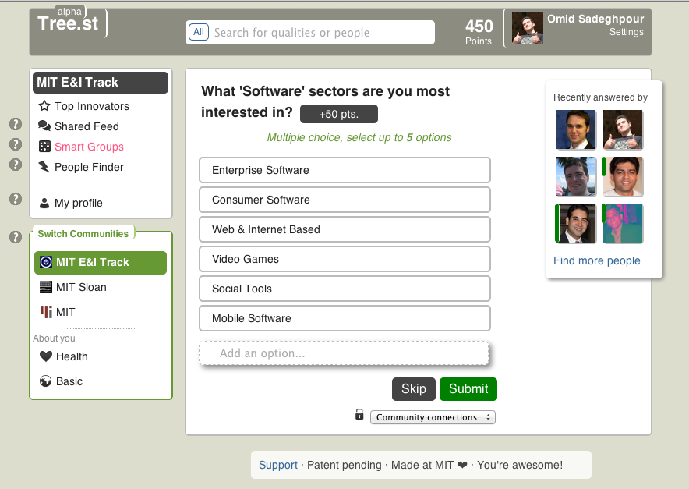
/ Appendix A, Data Gathering
Data Gathering – when members join they are asked community specific questions driven by an underlying decision tree. Members can be incentivized to answer questions by gaining points. Because Tree.st gathers very specific member details we expect the lifetime value of our customers to be higher than normal

Slide 14
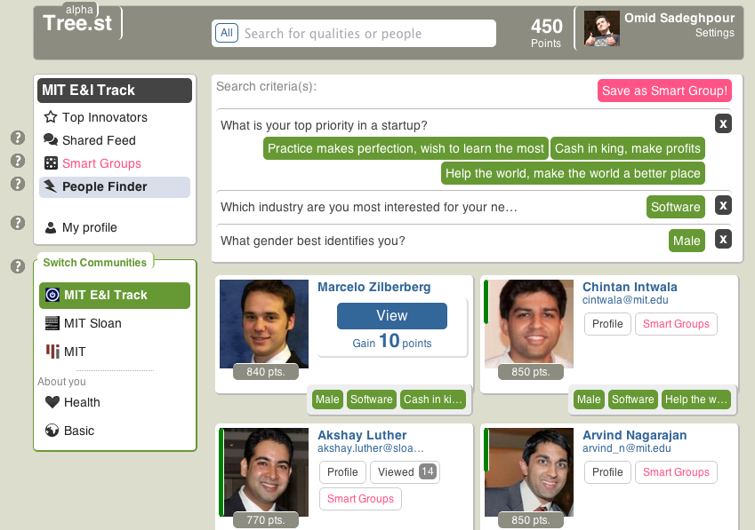
/ Appendix B, People Finder
Appendix B – People Finder
Search
Demonstrates a search for a “male” entrepreneur interested in the “software” industry who wants to either “help the world,” “make cash,” or “just learn” about startups by practicing.
Gamification
In this community users “gain 10 points” for viewing one another, in another community users might have to “pay 10 points” to view one another. Users can also set custom points based on their schedule and availability to encourage or discourage others from contacting them.

Slide 15
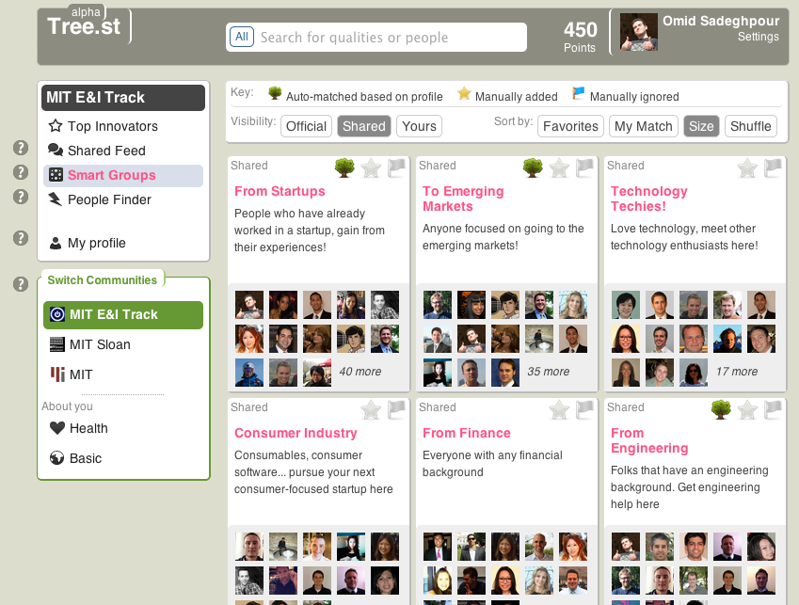
/ Appendix C, Smart Groups
Smart Groups – community members can create “smart” groups that add new and old members to the group based on how well a user matches the “smart” group’s search criteria. These “smart” groups are great for dynamic and transitory populations

Slide 16
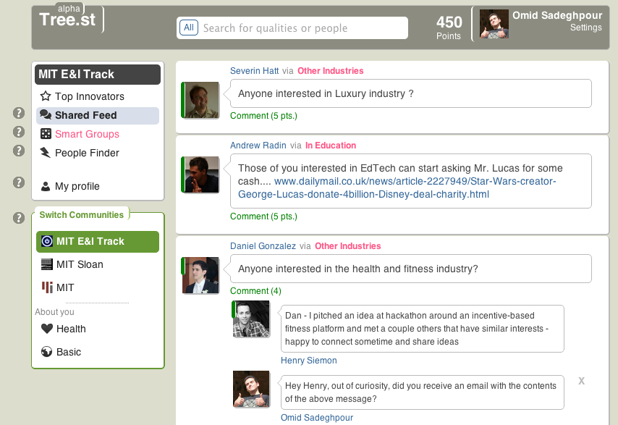
/ Appendix D, Communication
Communication – members post messages at the “smart” group level, this keeps conversations relevant and to the point. “Smart” group messages can then be viewed at the community level where all “smart” group messages are combined into a single view uniquely made based on the member’s interest

Slide 17
/ Appendix E, Financials
With two product tiers (SaaS & Enterprise in-location) we will breakeven in 14 quarters (3.5 years). We expect to spend capital early on in marketing and sales. Given our projections, Tree.st will have early stage financials similar to LinkedIn and Microsoft

